Slide 1

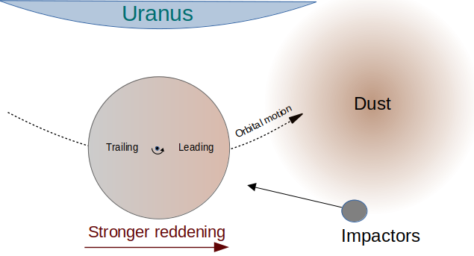
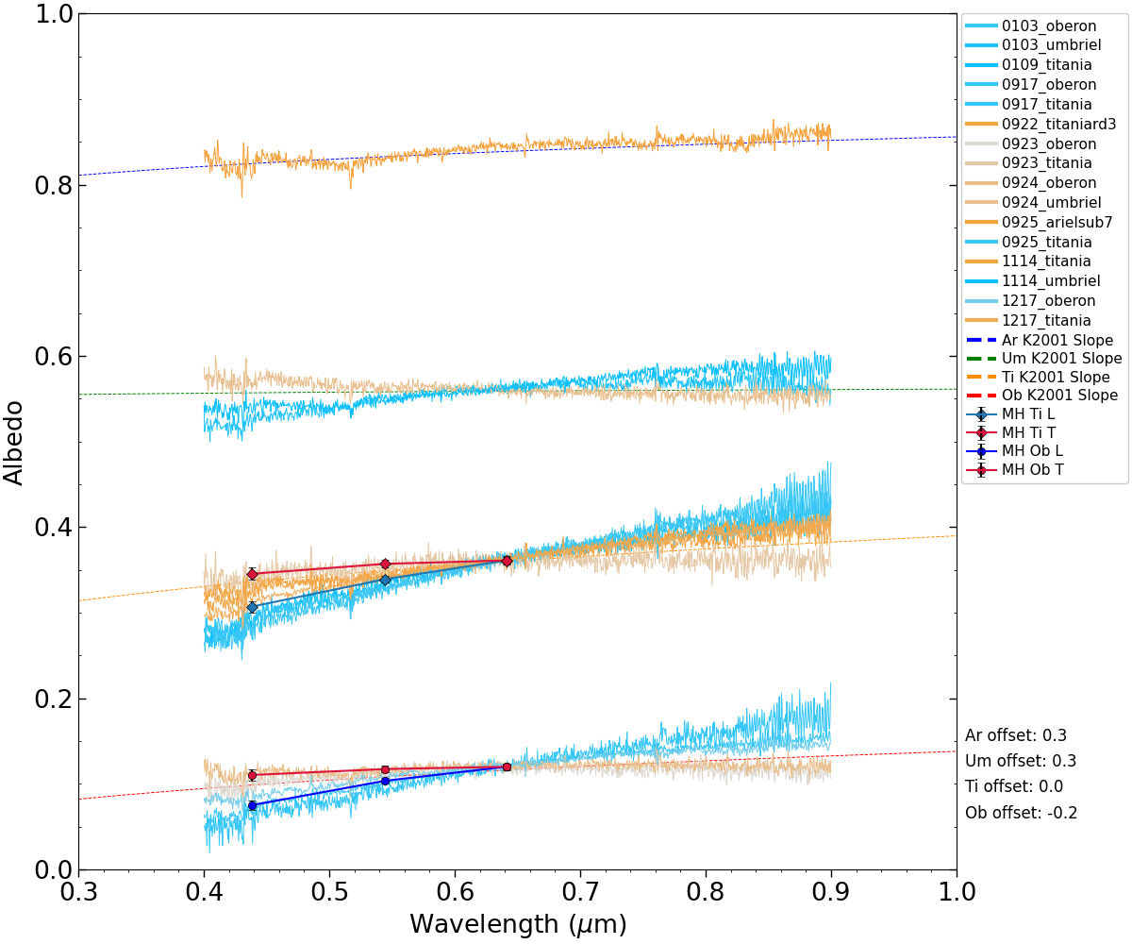
National Aeronautics and Space Administration
Postdoc Research
Visible-Wavelength Spectra of the Uranian Satellites
Riley DeColibus (NASA Postdoctoral Fellow, 3222)
Bonnie Buratti (320), Richard Cartwright (JHU APL), Will Grundy (Lowell Obs.), Michael Hicks†
Background
The moons of Uranus have been the focus of renewed interest thanks to the 2023-2032 Planetary Science Decadal Survey, which recommended a Uranus orbiter mission as the highest priority new Flagship mission in the next decade [1]. Differences in the colors of the leading and trailing hemispheres of Umbriel, Titania, and Oberon were detected in Voyager 2 imaging data [2]. Reflectance spectroscopy of the moons’ surfaces at visible wavelengths could constrain color and spectral slope differences between their leading and trailing hemispheres, which could be indicative of external processes affecting their surfaces (Figure 1). For example, the leading hemisphere of a moon will receive more impacts from dust and meteorites, in the same way that more bugs hit your front windshield than the back window when you’re driving on the highway. Over time, this can build up such that the leading hemisphere of the moons are covered by dark dust originating from outer irregular moons [2]. However, previous studies have not thoroughly investigated leading/trailing asymmetries in visible-wavelength spectra of the Uranian moons.
Objectives
We are analyzing previously unpublished spectroscopic data sets acquired with ground-based telescopes. By quantifying variations in the spectral slope of each moon as a function of both longitude (leading/trailing hemisphere) and latitude, we aim to constrain whether these variations in color originate from external or internal processes.
Approach and Results
We are analyzing visible-wavelength spectra of the Uranian moons from the Palomar 200” telescope and Lowell Discovery Telescope. Our results (Figure 2) support previous studies suggesting that the leading hemispheres of the Uranian satellites are more reddish than their trailing hemispheres [2,3]. This is likely due to the leading hemispheres of the moons being mantled by dust populations originating from Uranus’s outer irregular satellites. A similar process is thought to be responsible for the dark leading hemisphere of the Saturnian moon Iapetus [4,5]. No previously undiscovered narrow absorption features are evident in our spectra.
Figure 1: A diagram of how external processes can affect one side of a moon more than another.
Significance of Results/Benefits to NASA/JPL
This work incorporates a thorough investigation of spectral properties of the Uranian satellites at a significantly higher spectral resolution and signal-to-noise ratio than previous work. We will provide our final spectral data files upon publication in a peer-reviewed scientific journal, resulting in an open-access, high-quality spectroscopic data set.
Future Work
This work is nearing completion and will be submitted to a peer-reviewed journal by the end of this year. Future studies could use these spectra in combination with UV and near-IR data to produce more accurate spectral models of surface composition.
Figure 2: Spectra of the leading and trailing hemispheres of four Uranian moons obtained with the Lowell Discovery Telescope. The leading hemispheres (shades of blue) of Titania and Oberon (the bottom two spectra groups) have a more reddish slope than their trailing hemispheres (shades of orange). Data points with errors are photometry taken with the Table Mountain Observatory 60” telescope in 2005.
References:
[1] National Academies of Science, Engineering, and Medicine (2022), National Academies Press
[2] Buratti & Mosher (1991), Icarus, 90, 1
[3] Cartwright et al. (2018), Icarus, 314, 210
[4] Tamayo et al. (2013), Icarus, 226, 655
[5] Buratti et al. (2002), Icarus, 155, 375
Publications and Acknowledgements:
DPS 54 oral presentation, October 10, 2024
Manuscript in preparation
Author Contact Information:
(626) 429-2783, riley.a.decolibus@jpl.nasa.gov
National Aeronautics and Space Administration
Jet Propulsion Laboratory
California Institute of Technology
Pasadena, California
www.nasa.gov
Clearance Number: CL#00-0000
Poster Number: PRD-P-005
Copyright 2024. All rights reserved.

